Slide 1
SW Programming Project
#2. (Algorithm & Solution)

Slide 2
Criteria
To search the most appropriate file relevant to ‘keyword’, I think the ‘level of relevance’ is determined by how useful the files are.
And I design 4 criteria to generalize which file is most useful.
1. Is ‘file name’ include the keyword?
2. How many times the keyword appear in files.
3. Is the keyword distributed regularly in file?
4. How early the keyword appear.

Slide 3
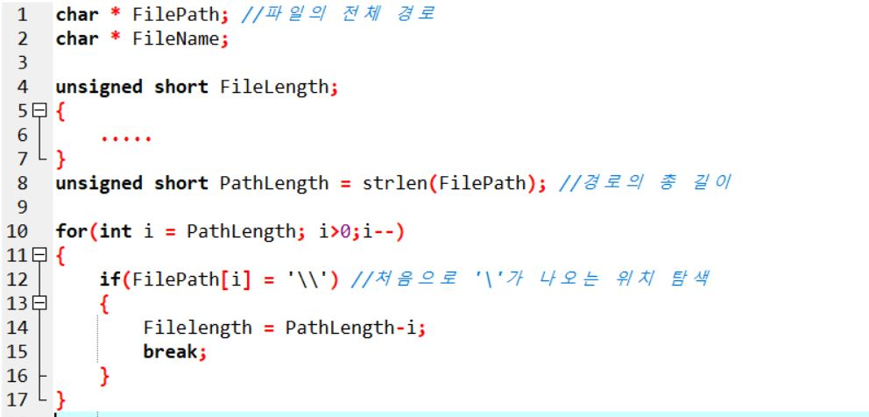
Algorithm – 1.File Name
I could use path of file(string) and simple repetitive station to bring file’s name, exploiting the feature of ‘\’.
=>Find the first ‘\’ position
But this algorithm takes too many time, and hard to handle because to save the filename, must use malloc and realloc several times at each file.

Slide 4
Algorithm – 1.File Name
Last time, I choosed basename() function to bring file’s name, but this function is used on about php or linux system, not C.
But in general, there is “_finddata_t” struct which is in <io.h> header file. It can bring lots of information about the file, but also the list of file that is in certain directory.
This is the suitable struct for this topic.

Slide 5
Algorithm – 1.File Name
About _finddata_t struct
_findfirst() = move the pointer in front of file list, and bring it.
char name[_MAX_PATH] = name of file which is brought by _findfirst()
_findnext() = move the pointer to next file, and bring it.
_fsize_t size = length(byte) of file.

Slide 6
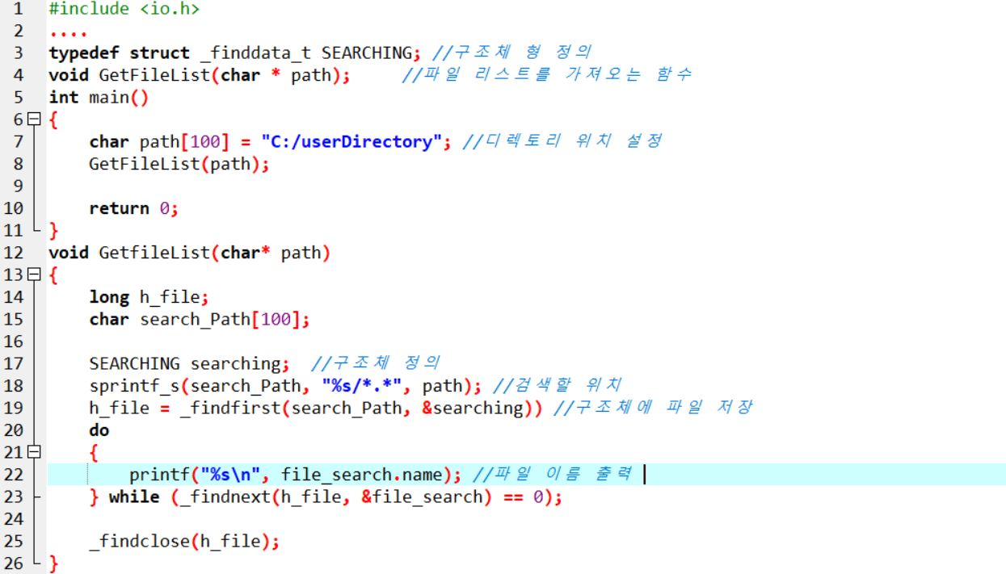
Algorithm – Example(NOT project itself)

Slide 7
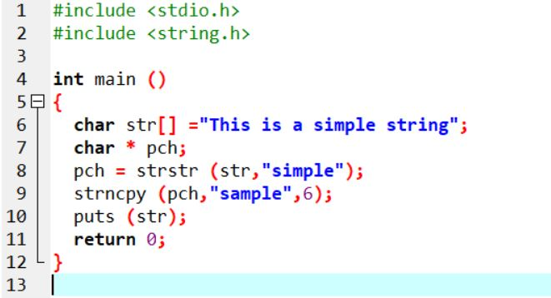
Algorithm – 2. Find Keyword
I can use ‘strstr()’ function that can search certain string in string.
strstr() return the position where searching string(keyword) appear first.

Slide 8
Algorithm – 2. Find Keyword
If we can bring all strings in file(regardless of row), I may could delete the first character one by one until keywords appear.
And save the distance between keywrods in certain array, to find the file whose keywords appears first of all.
(It is relevant of 4th criteria)

Slide 9
Algorithm – 3. Keyword Distributed
If saving the distance between keyword to use strstr(), we can also calculate the ‘standard deviation(표준편차)’ of distance between a keyword and the next keyword.
We have to use <math.h> header file. but there is no function that calculate standard deviation directly, so just use fundamental rules.

Slide 10
Next time…..
I don’t care about time or memory yet.
After trying various algorithm or function, control and optimize coding to get faster time.

